Slide 1



Indian Agriculture Analysis
View in Power BI
Last data refresh:
3/29/2024 5:56:17 PM UTC
Downloaded at:
3/29/2024 6:30:02 PM UTC

Slide 2
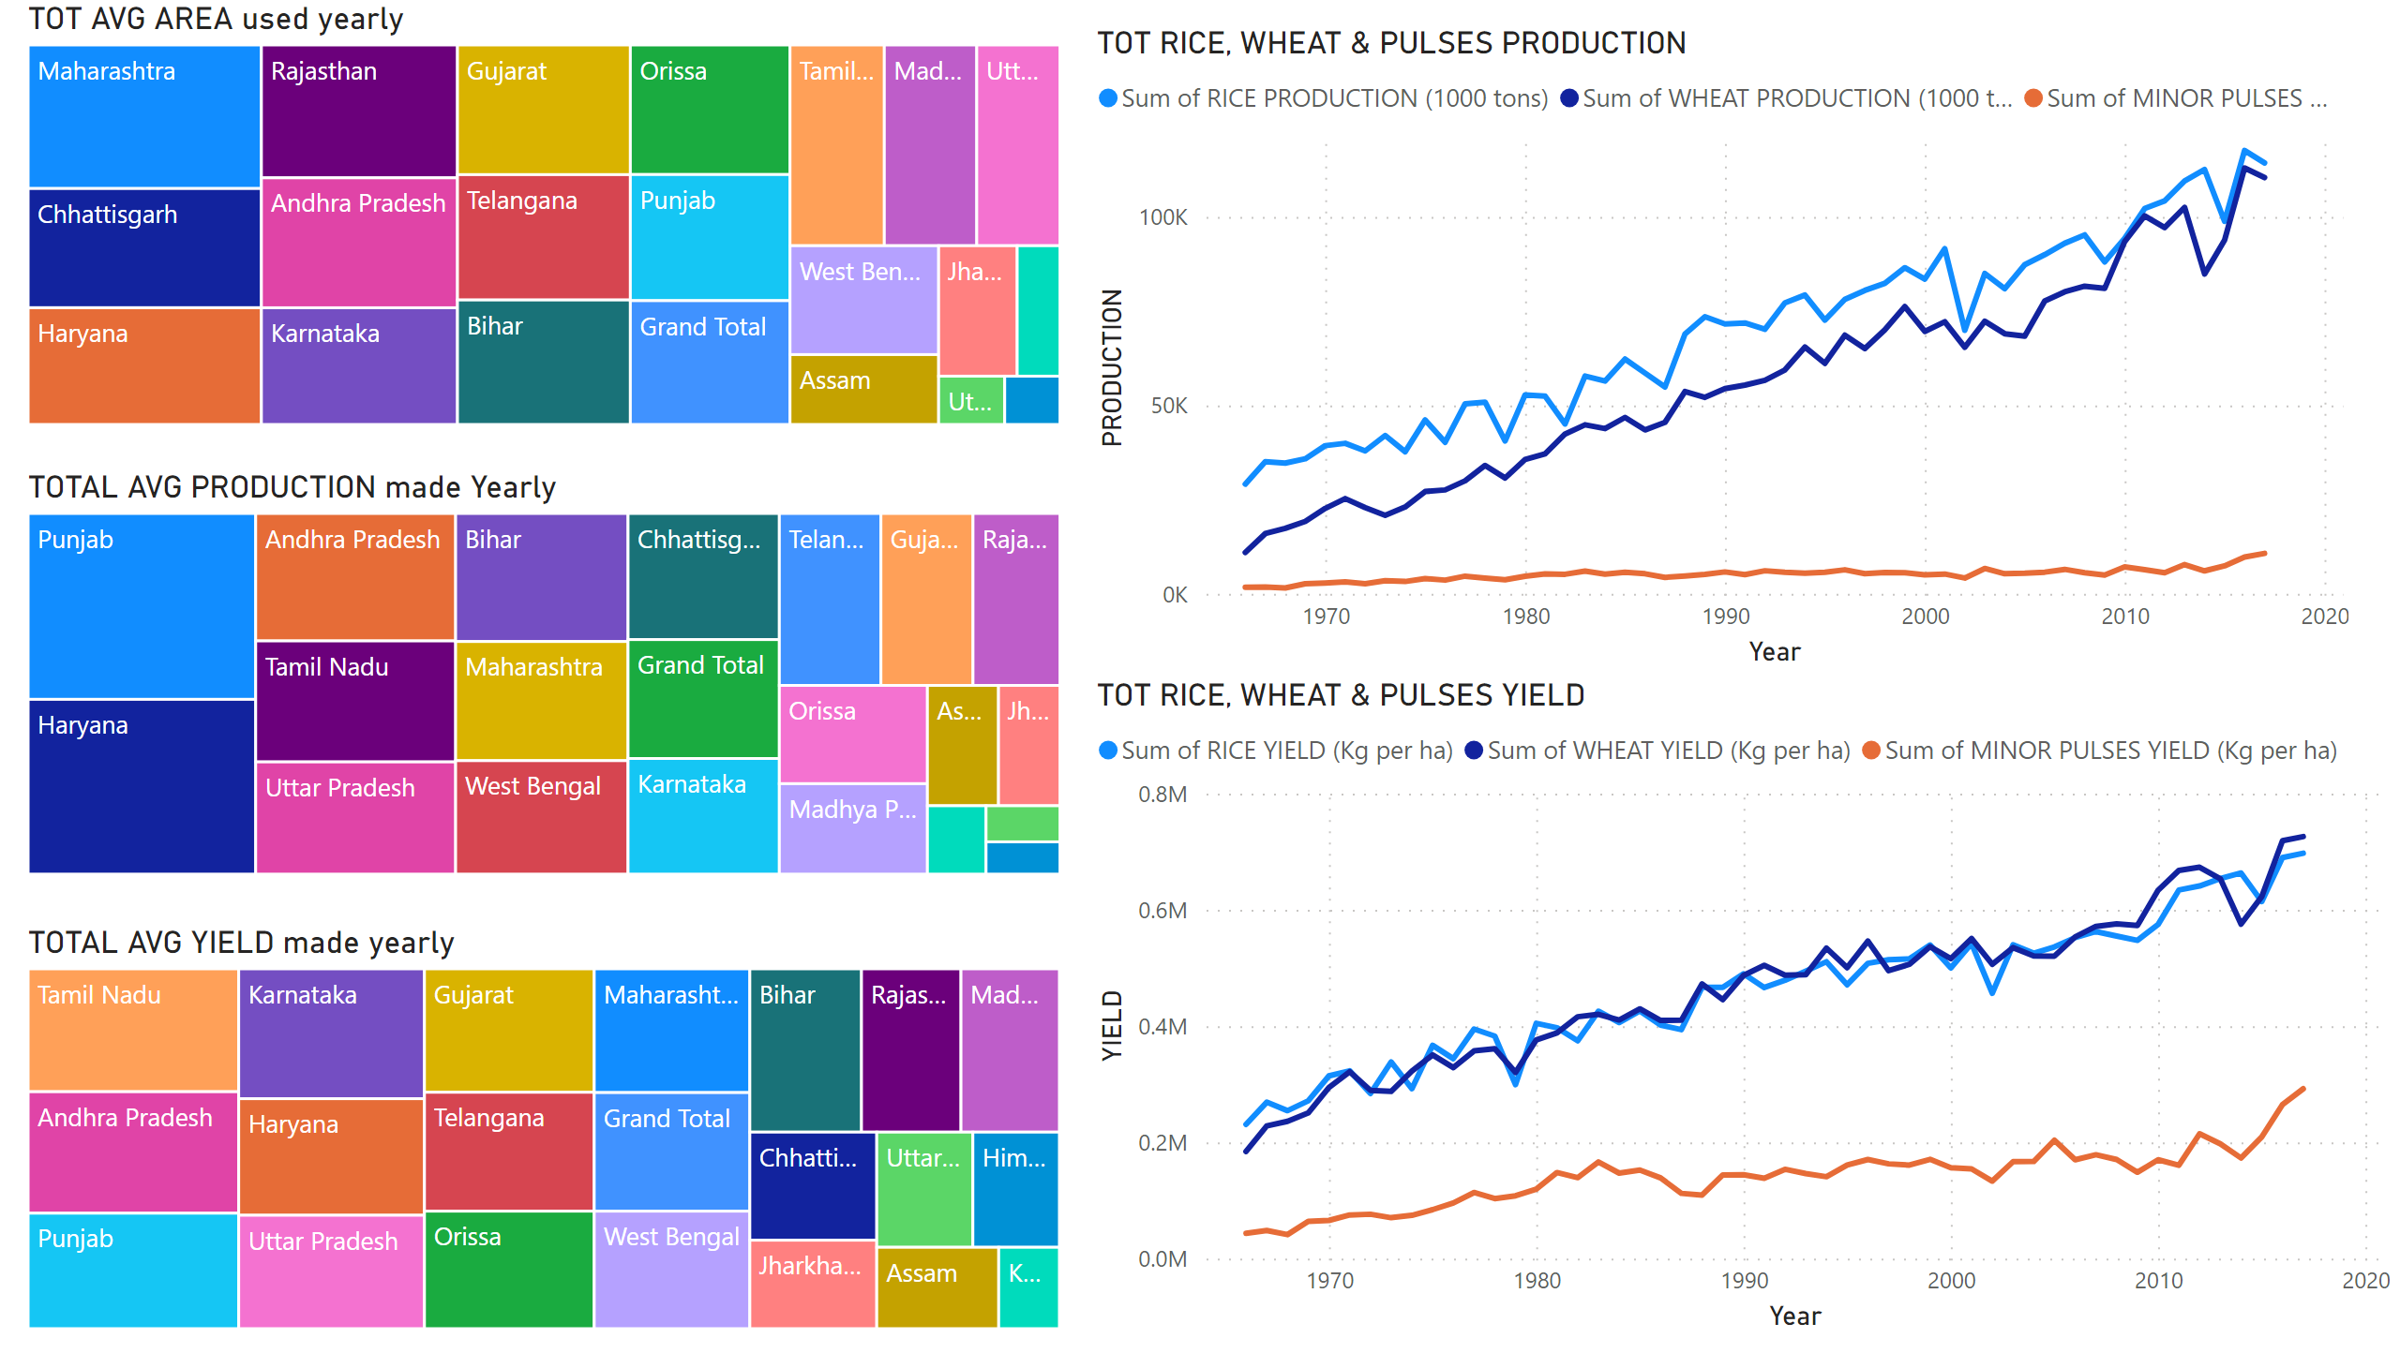
Page 1
Notes:
TOT AVG AREA used yearly
Total average area used yearly(visuals 1, 2, 3) & the total production & yields of rice, wheat and pulses(visuals4,5)
TOTAL AVG PRODUCTION made Yearly
No alt text provided
TOTAL AVG YIELD made yearly
No alt text provided
TOT RICE, WHEAT & PULSES PRODUCTION
No alt text provided
TOT RICE, WHEAT & PULSES YIELD
No alt text provided

Slide 3
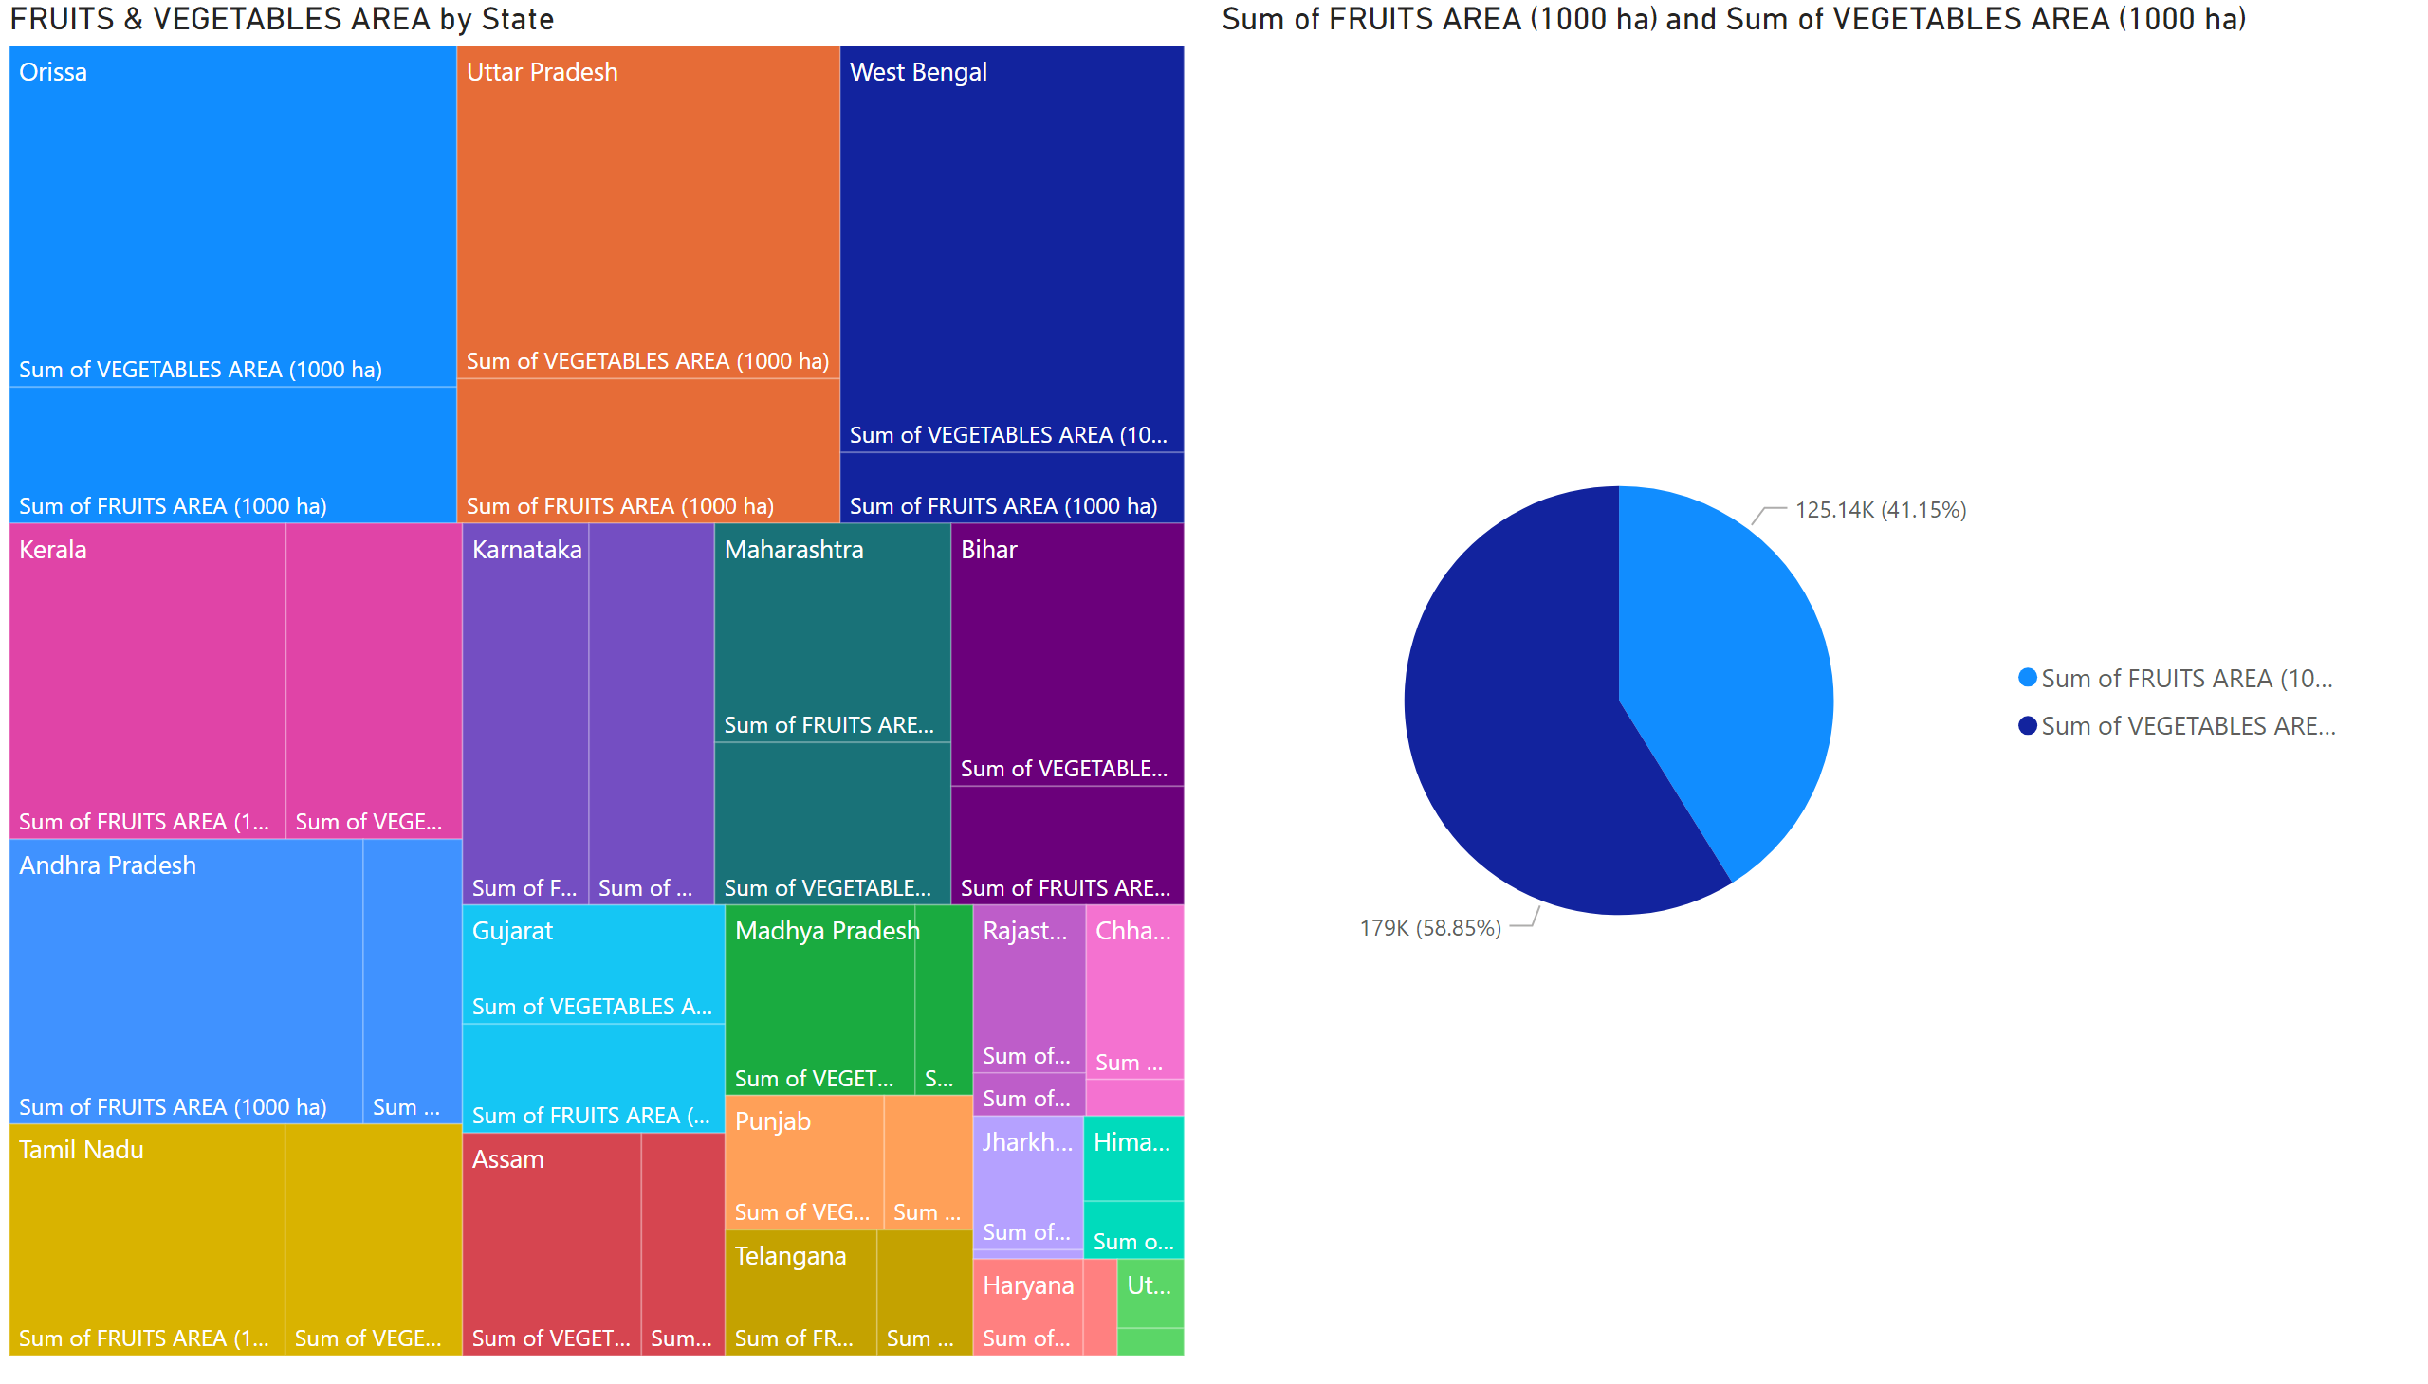
Page 2
Notes:
pieChart
Area occupied by fruits & vegetables
FRUITS & VEGETABLES AREA by State
No alt text provided

Slide 4
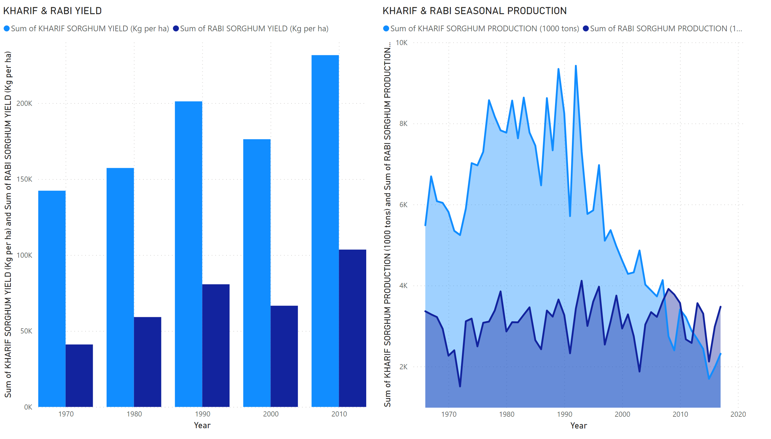
Page 3
Notes:
KHARIF & RABI SEASONAL PRODUCTION
The production & yield of kharif and rabi
KHARIF & RABI YIELD
No alt text provided

